Slide 1
COMMON APP ACTIVITIES
SECTION

Slide 2
WHAT ARE EXTRACURRICULAR ACTIVITIES?
1

Slide 3


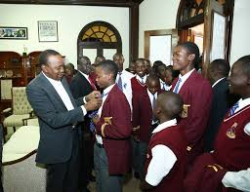

The Common App activities section is an opportunity to demonstrate to colleges your talents, skills, and specific extracurricular involvements over the last few years.
It is an opportunity to demonstrate your dedication to your preferred career path whilst flexing about your accomplishments ;)
You have limited space to describe each activity, so keep it concise yet descriptive.
“

Slide 4
10 Activities
In each activity, you will indicate:
-Activity Type (eg Science/Math, Religious, Art, Cultural, Dance, Debate/Speech, Internship, Community Service)
-Position/Leadership Description (eg Chairperson/Founder/Secretary/Delegate/Member)
- Organization Name (eg Nairobi Academy Music Club)
-Description of Activity (150 characters), include any relevant accomplishments
-Participation Grade levels (9th/10th/11th/12th/Post Graduate or PG)
-Timing (During School Year/School Break/All Year)
-Hours per week (Be realistic!!!!!!!!!)
-Weeks per year (Be realistic!!!!!!!!!)
- Whether you intend to continue with the activity in college

Slide 5


EXAMPLES?

Slide 6

MATH/SCIENCE-RELATED (A GOOD FIT FOR APPLICANTS TO THE COLLEGE OF ARTS AND SCIENCES, FOR MAJORS SUCH AS BIOLOGY MAJOR ETC.
Examples include clubs and activities related to:
Biology
Chemistry
Physics

Slide 7
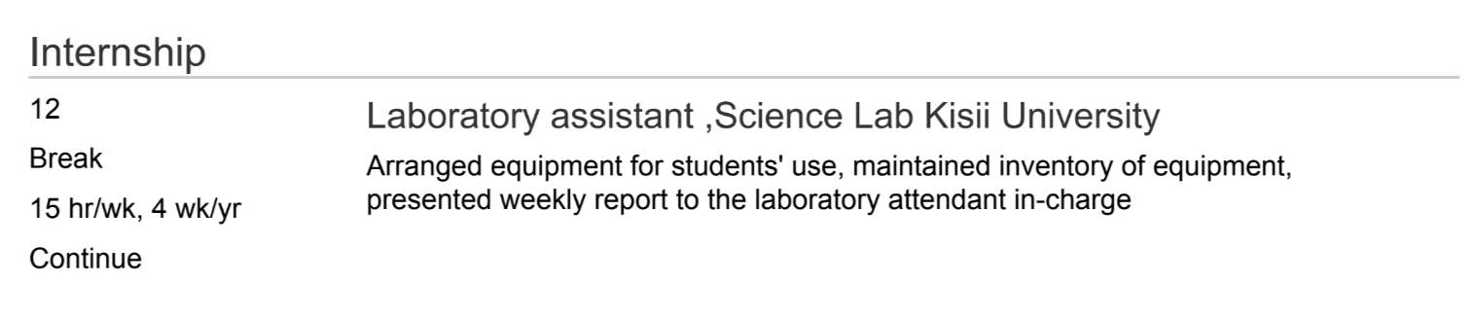

Examples (Science)

Slide 8

ENTREPRENEURSHIP RELATED(A GOOD FIT FOR APPLICANTS TO THE COLLEGE OF BUSINESS FOR MAJORS SUCH AS FINANCE, APPLIED ECONOMICS ETC.)
Examples include clubs and activities related to:
Finance
Business
Economics

Slide 9
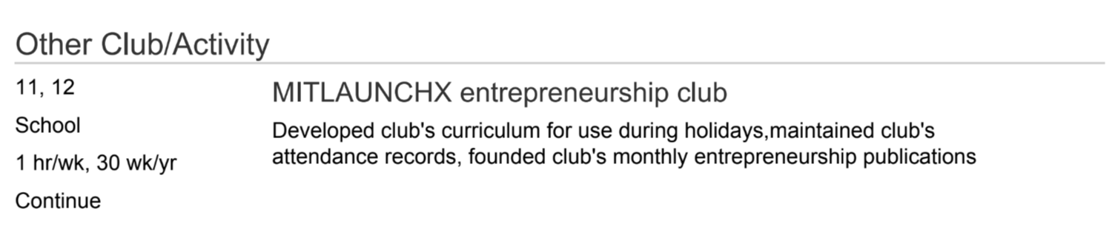
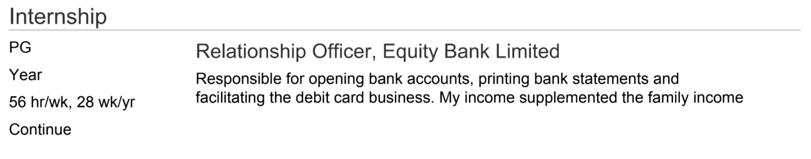
Examples (Business)

Slide 10

RELATED TO ENGINEERING (A GOOD FIT FOR APPLICANTS TO THE COLLEGE OF ENGINEERING FOR A MAJOR SUCH AS ELECTRICAL ENGINEERING)
Examples include clubs and activities related to:
Electronics
Robotics
Coding and Programming

Slide 11
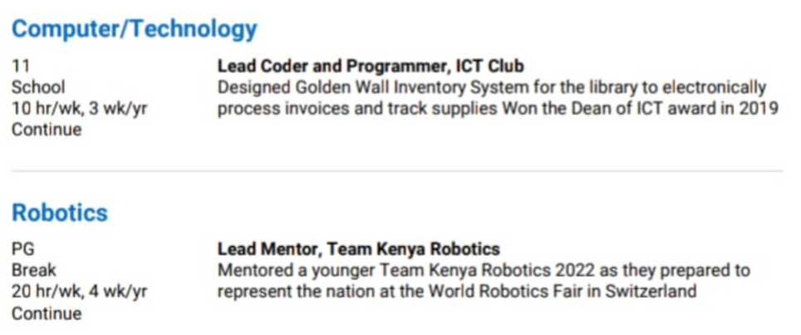
Examples (Engineering)

Slide 12

LANGUAGES RELATED(A GOOD FIT FOR LANGUAGE MAJORS)
Examples include clubs and activities related to:
Debate club/Model United Nations
Literature club
Writing/Journalism club

Slide 13
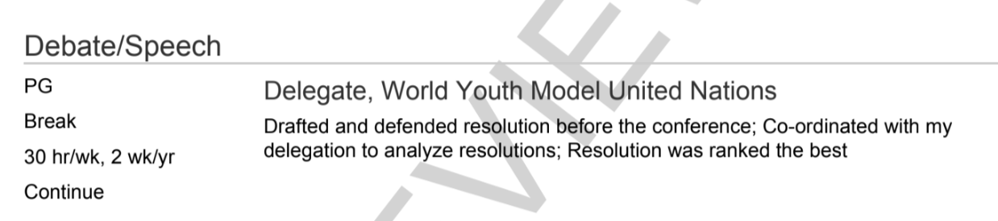
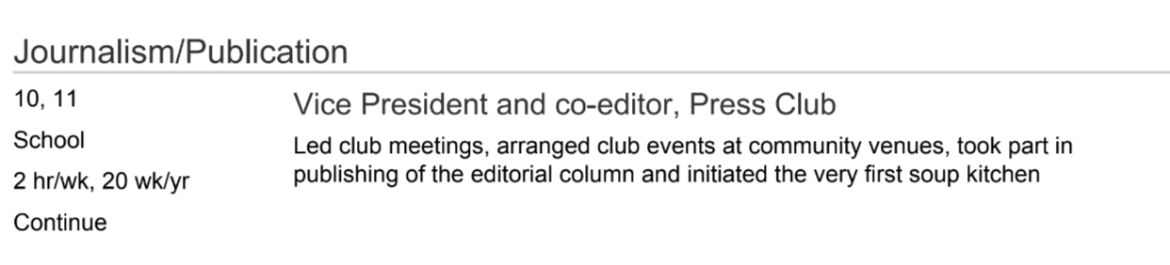
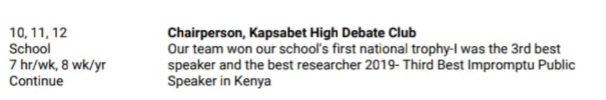
Examples (Language)

Slide 14
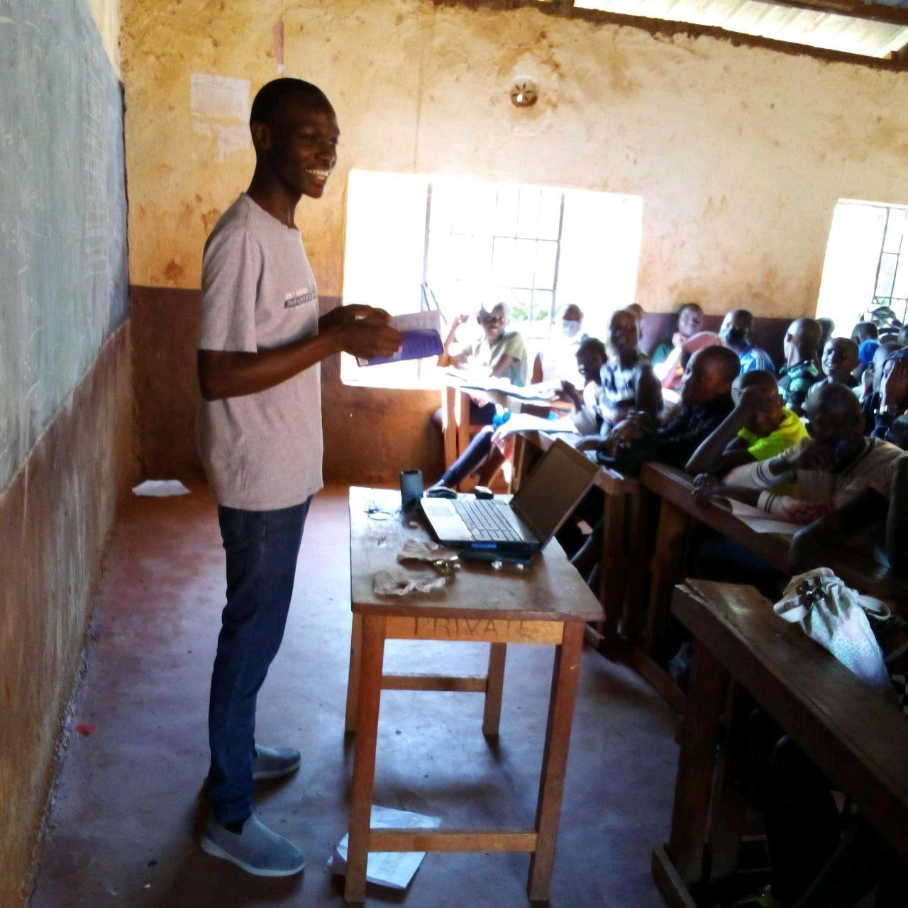

VOLUNTEER WORK
“A voluntary act of an individual or group freely giving time and labor for community service
”

Slide 15
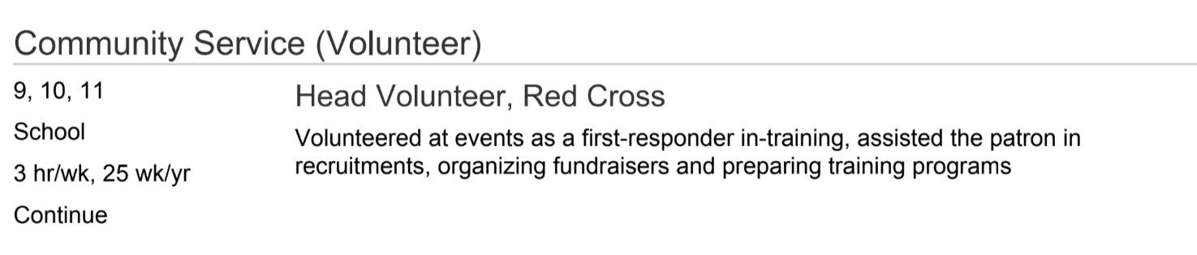
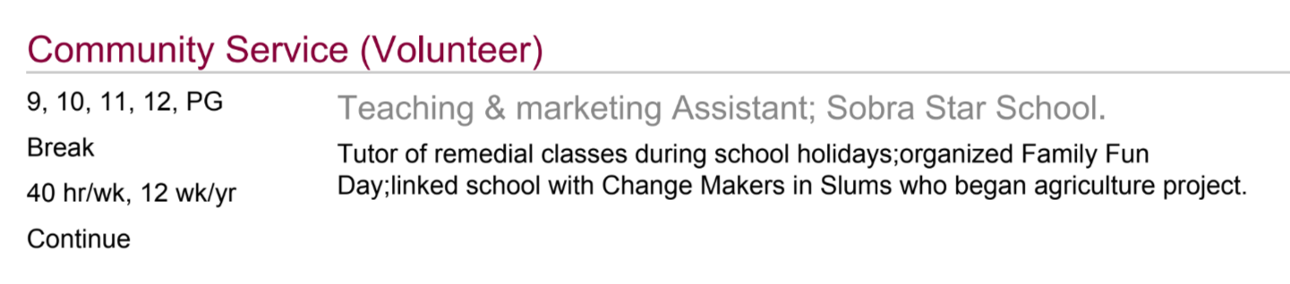
Examples (Volunteering/Community Service)

Slide 16
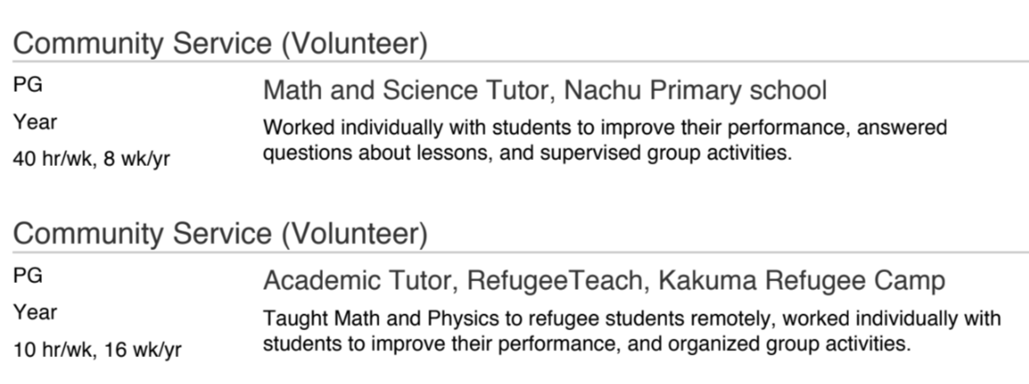
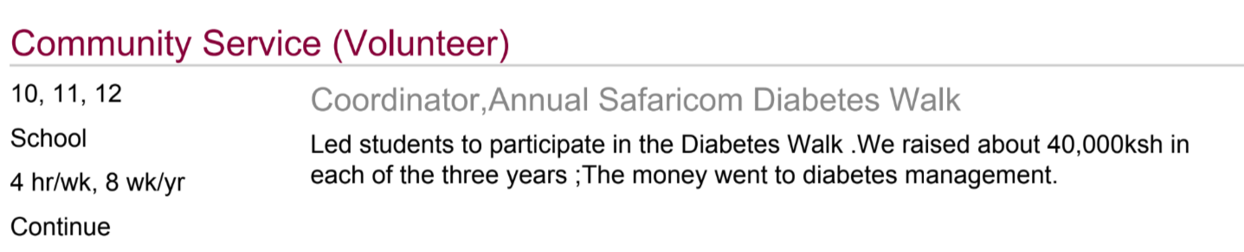
More Examples (Volunteering/Community Service)

Slide 17
WHY ARE EXTRACURRICULAR ACTIVITIES IMPORTANT TO YOUR APPLICATION?

Slide 18

BECAUSE……………..
1. More or less determine the major you going to apply with
2. They branch off to become essays and recommendations
3. Pillars of your personal brand can be shown via your activities.

Slide 19

WHAT ARE SOME OF THE PERSONAL TRAITS COLLEGES LOOK FOR IN PROSPECTIVE STUDENTS?
PASSION
* Devotion
* Commitment
* Enthusiasm
* Energy
COMPASSION
* Kindness
* Generosity
* Selflessness
* Community awareness
INTERPERSONAL SKILLS
* Leadership
* Teamwork
* Cooperation

Slide 20
Sample Verbs to Use

Slide 21
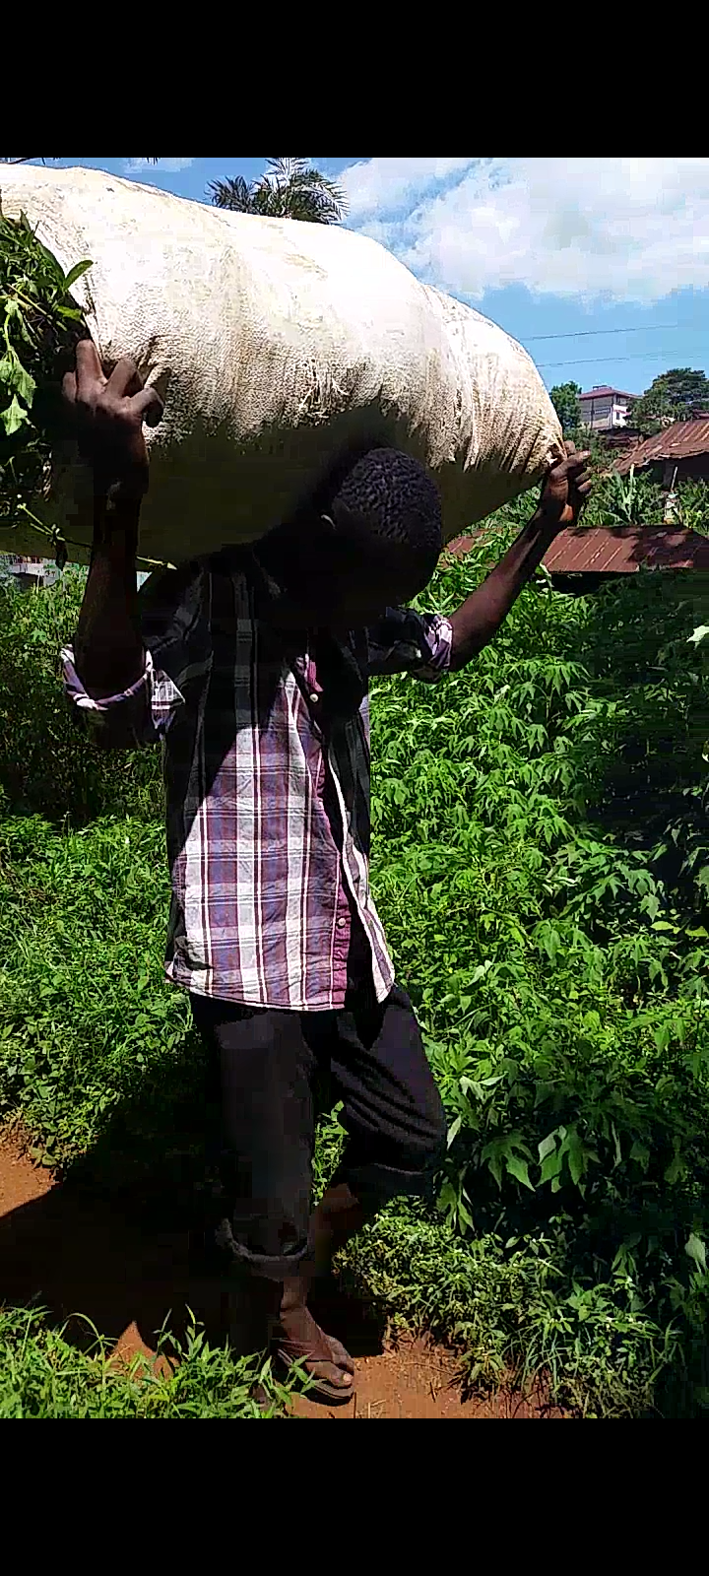
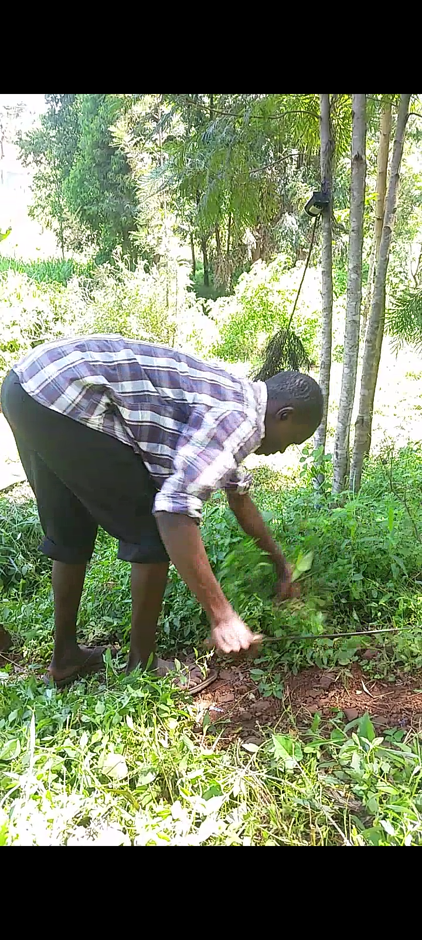
Commitment and Impact!
“The quality of a person’s life is in direct proportion to their commitment to excellence, regardless of their chosen field of endeavor.” – Vince Lombardi

Slide 22

SAMPLE BORING ACTIVITIES
1. I created a website for the school.
2. I served as a peer counselor. I helped students with their problems.
3. I was a member of the Christian Union
4. Taught my former primary school after graduating from high school.
5. Did research about agricultural sales

Slide 23

Refined Activities List Description
1. Used contemporary HTML & CSS to build the school Website; Consolidated 3GB of revision material to the website bolstering school mean by 30%
2. Mediated students’ conflicts, stopped 3 suicide attempts; Raised Ksh50000 to buy sanitary pads for 98 underprivileged girls in the school neighborhood
3. I Participate in Bible Study, Offered Summons when called upon by the Chairperson & worked with the organizing secretary to plan trips & invitations
4. Taught 40 grade 11 students Biology & computer studies; Registered a performance increase of 22% in Biology & 20% in computer studies
5. Led a team of 15 researchers in exploring ways to deepen the agric domestic Mkt through ICT; Drafted the findings into a bill for the county assembly

Slide 24

KEEP IN MIND THESE IMPORTANT POINTS ABOUT YOUR EXTRACURRICULAR RECORD

Slide 25
DEPTH OF INVOLVEMENT: Show that you have been committed to one or more activities for a length of time, preferably three or more years. Show that you have advanced within at least one activity and consistently devoted substantial time to it over several years.
LEADERSHIP: Show that you have taken on an important leadership role in at least one activity. This means founding a club or group, becoming elected into the student government, etc.(Chairlady/Vice Chairlady, Chairperson, Founder/Co-founder, Team Leader…) Show that you can motivate others around you to contribute their best efforts to a common cause.
TEAM PLAYER: In as much as you want to show that you have been a leader, you want to show the AOs that you can work well in a team, a core requirement in your freshman year,
DEPTH OF INVOLVEMENT
LEADERSHIP
TEAM PLAYER

Slide 26
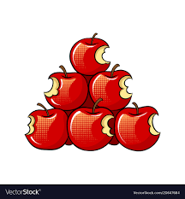
AVOID BEING ALL-ROUNDED!!
Possession of at least two dimensions
NOTE
You want to present yourself as a focused individual with a memorable profile, not someone who dabbles in everything without much commitment to any one particular activity. But avoiding the tag of “well-rounded student” does not mean you should become one-dimensional. Be sure that there is at least one activity you can point to that stands out as not fitting into your main positioning effort.
Some diversity is good in the sense that you have one primary interest and at most two secondary interests make your application stand out for instance Agriculture, community, and environmental awareness.
1
2

Slide 27

HOW MANY ACTIVITIES SHOULD YOU LIST?
College admissions officers would prefer to see a few activities that you have made significant dedication to THAN too many activities that you have had lesser involvement in.
It’s recommended that you have at least 10 activities that you were invested in and interested in. Don’t just write activities to fill the activities section.
Don’t write very few activities on your activity list e.g. 4 activities are very few which show that you’re not serious. But then again don’t write about too many boring activities.

Slide 28
ARRANGEMENT
Make sure that the order you put them in is the order of importance they have for you according to your passions and interests.
Don’t just try to guess what the admissions officers want to see, because the whole point is to show off what is important to you. The first few can be based on your primary career interest.
You should base this using the amount of time you dedicated to the project, your leadership in the activity, and how important the activity has been for developing a passion or pursuing a future goal.

Slide 29
Continuation…
So try as much as possible to put the most impressive ones first and the ones that strongly demonstrate your passions. And maybe as you come down, start including secondary interests

Slide 30


Quick Note about
MIT is not on the Common App. It has a separate application platform.
It only asks for 4 activities. Therefore, you must show high involvement in these 4 activities.
This includes leadership positions, activity done over several years, and awards/honors.
However, there is additional space to talk about “summer activities”, an “activity done for fun” and “jobs”

Slide 31


ANY QUESTIONS?

Slide 32


☺

